Slide 1

Welcome to
Year 3 and 4

Slide 2
Meet the Team:
Miss Gangat (Phase leader) Mrs Sacranie Year4 Mrs Sumner Year3
Miss Simmonds Miss Ashby Miss Tuxford Miss Plumb
Notes:
Add in photos of staff

Slide 3



English – Autumn Term
Year 3 and 4

Slide 4


Maths – Autumn Term
Year 3 and 4
Place value
Addition and subtraction
Multiplication and division

Slide 5
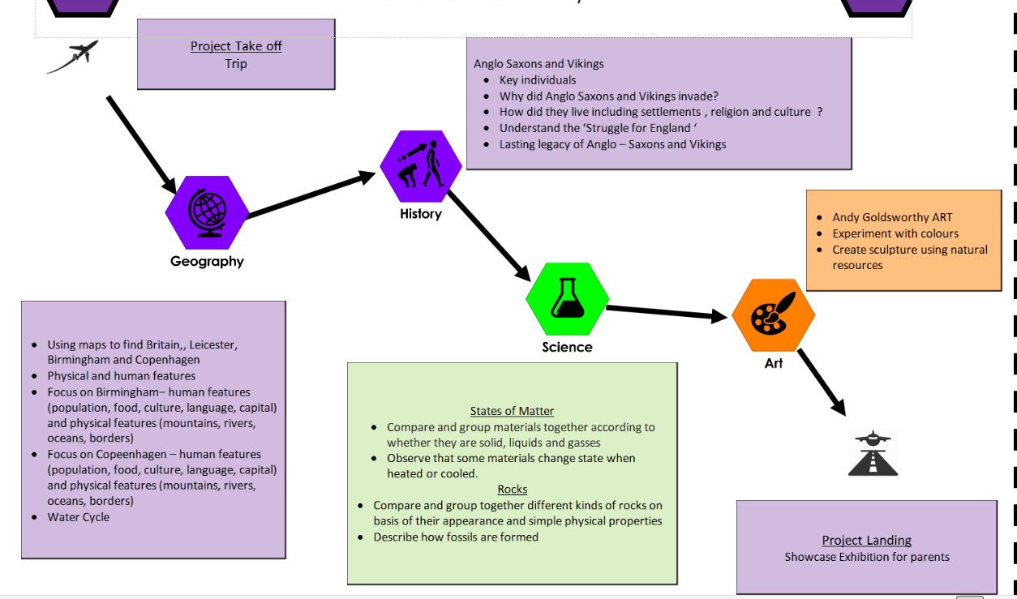
Project –
How did invaders change Britain ?

Slide 6
Trip –
Jorvik Centre
https://www.jorvikvikingcentre.co.uk/

Slide 7

Homework
Daily – Reading and times tables
Weekly Spellings
Weekly Homework – English and Maths
Termly family homework challenge

Slide 8


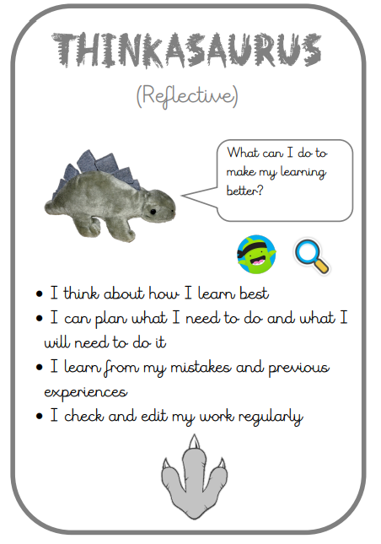


Learning Powers

Slide 9

Class Dojo
Barley Croft Dojo Shop

Slide 10

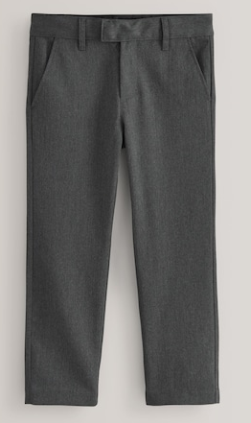
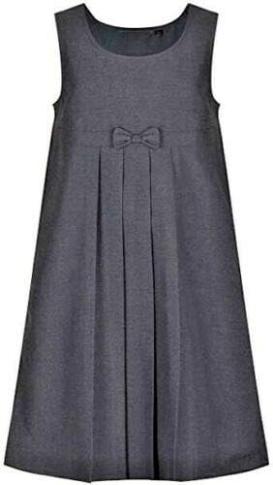




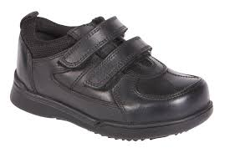
School Uniform

Slide 11





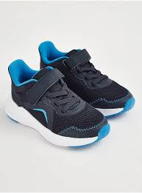
PE
Please ensure children come to school on their PE day dressed in PE kit.
Ambition - Mrs Sacranie
Monday
Integrity – Mrs Sumner
Tuesday
Democracy –Miss Gangat
TUESDAY
*

Slide 12
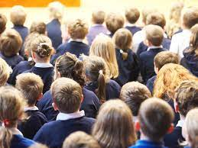


Returning this year…
Parent
Exhibition

Slide 13


Reminders

Slide 14
Contact
Class Teacher / Teaching Assistant
Phase Leader (Miss Gangat )
Senior Leader (Mr Easton, Mrs Ellson, Mr Canham &Mrs Dulieu)

Slide 15
Questions…

