Slide 1

Welcome to
Years 5 and 6

Slide 2
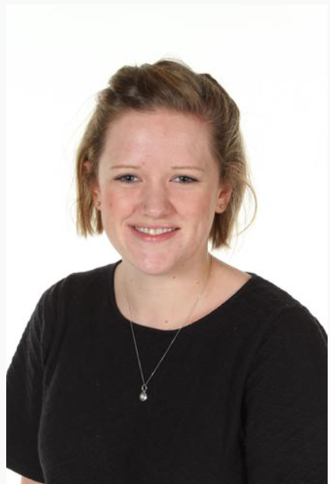
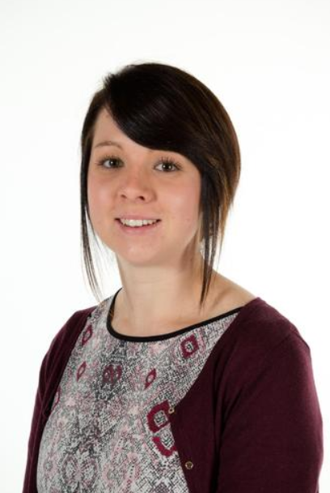
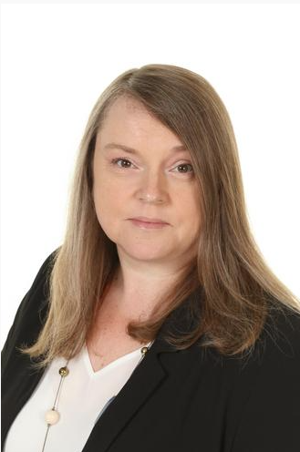
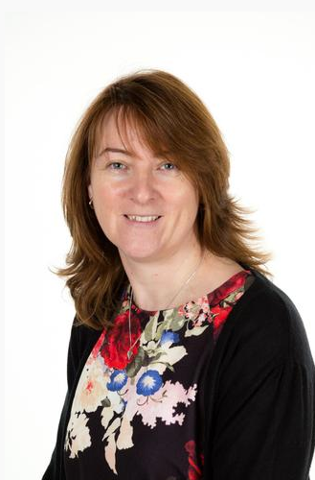
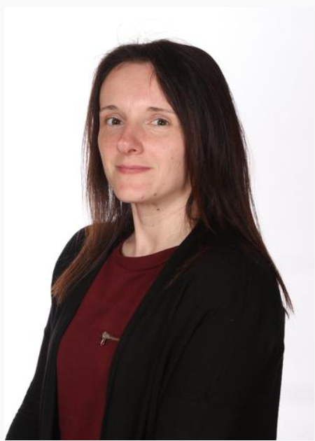
Meet the Team:
Mrs Bromley Miss Cockram Mrs Ellson Miss Ibrahim
Mrs Frith Mrs Pallet
Notes:
Add in photos of staff

Slide 3




English – Autumn Term
Years 5 and 6
Informal letter
Narrative
Diary
Explanation
Informal Letter
Narrative

Slide 4


Maths – Autumn Term
Years 5 and 6
Place value
Addition and subtraction
Multiplication and division
Fractions

Slide 5






Project –
What can we learn from History?
Project Take off
Artefact Investigation
Project Landing
Make a sewn decoration

Slide 6
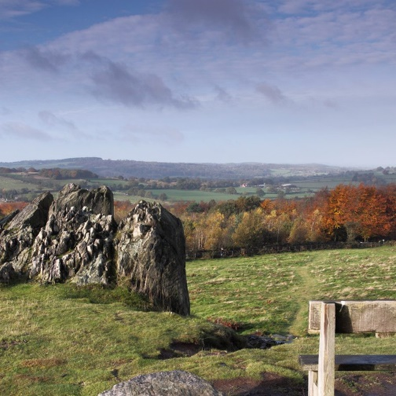
Trip –
Bradgate Park
29th August 2025 – Tomorrow!
During School hours
Lunch
Water bottle
Bag
Appropriate shoes!
Clothing
£5

Slide 7
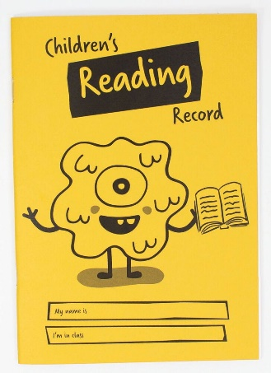

Homework
Daily – Reading and times tables
Weekly Spellings
Weekly Homework – English and Maths
Termly family homework challenge

Slide 8


Homework…

Slide 9
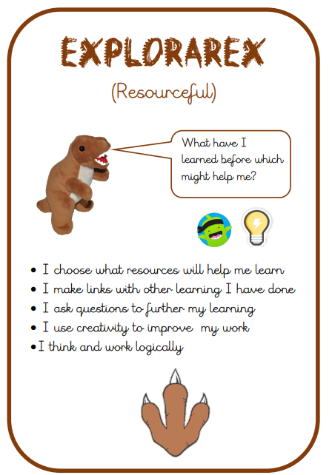

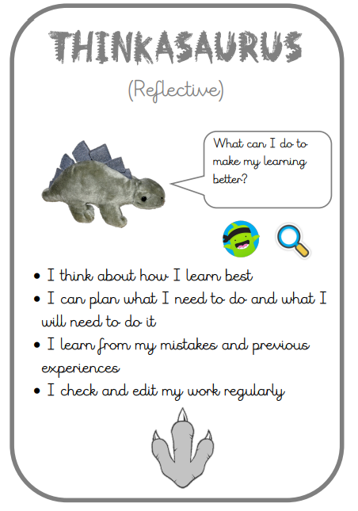
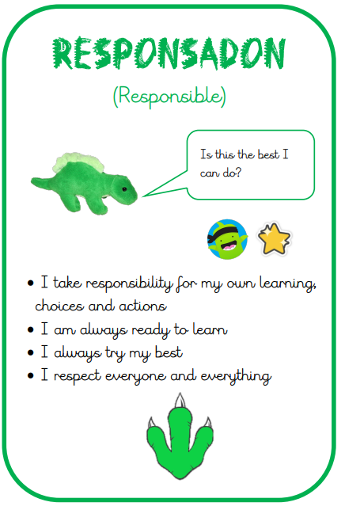
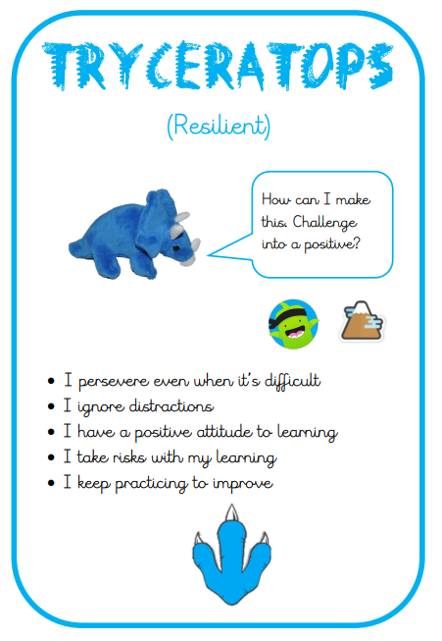
Learning Powers

Slide 10

Class Dojo
Barley Croft Dojo Shop

Slide 11
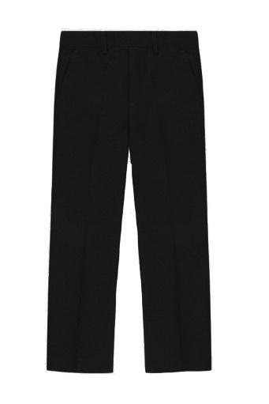
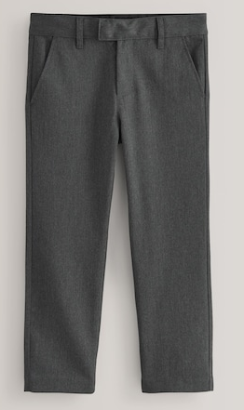
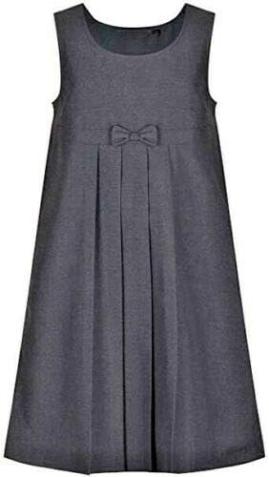
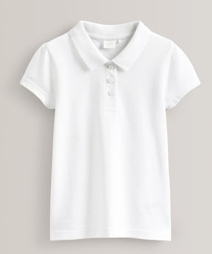
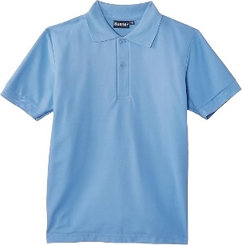
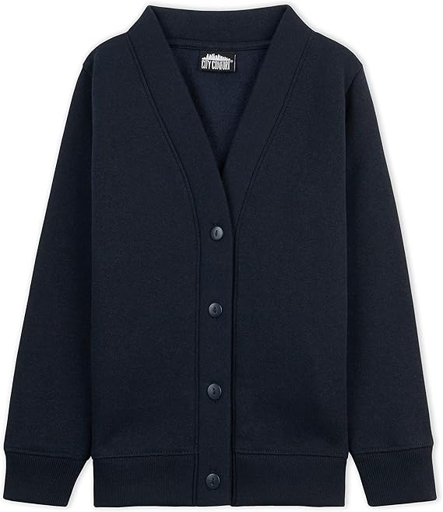
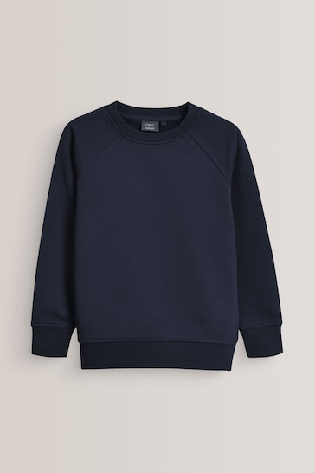
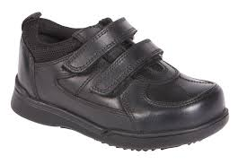
School Uniform

Slide 12
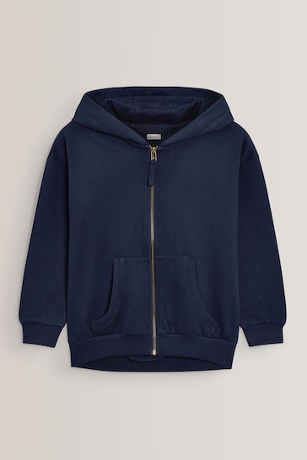
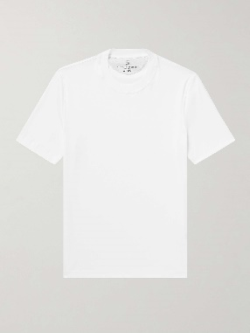
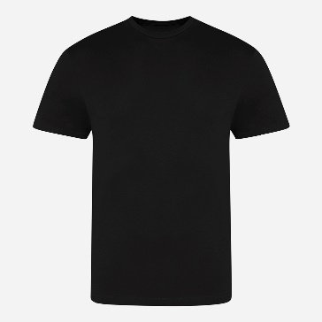
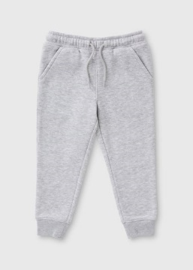
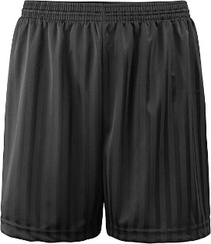
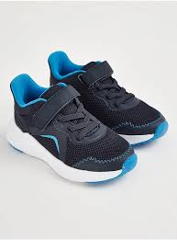
PE
Please ensure children come to school on their PE day dressed in PE kit.
Liberty – Mrs Ellson – Tuesday
Tolerance – Miss Ibrahim – Thursday
Community - Mrs Bromley and Miss Cockram
- Wednesday
*

Slide 13
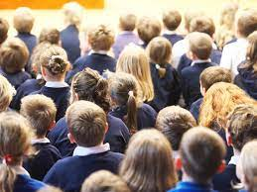


Returning this year…
Parent
Book Looks

Slide 14

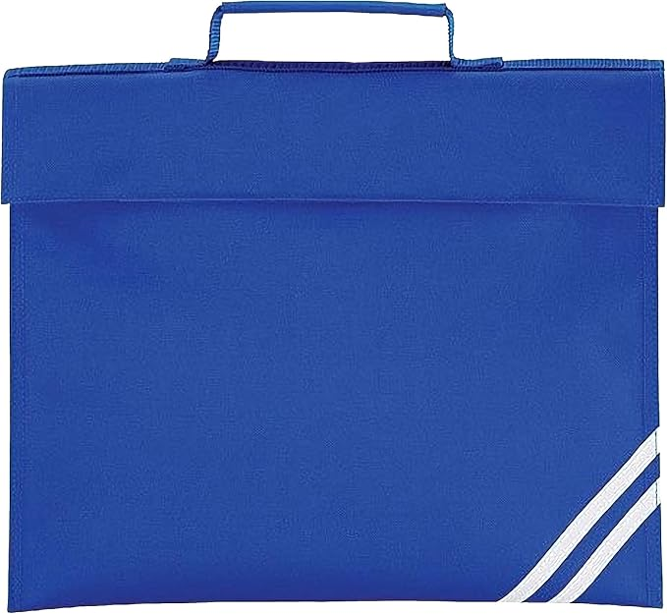
Reminders

Slide 15
Contact
Class Teacher / Teaching Assistant
Phase Leader (Mrs Bromley)
Senior Leader (Mr Easton, Mrs Ellson, Mr Canham &Mrs Dulieu)

Slide 16
Questions…

