Slide 1

Barley Croft Early Reading/Phonics Parent Workshop

Slide 2
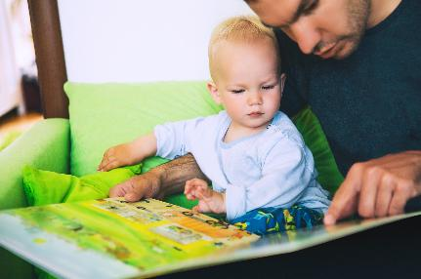





Slide 3
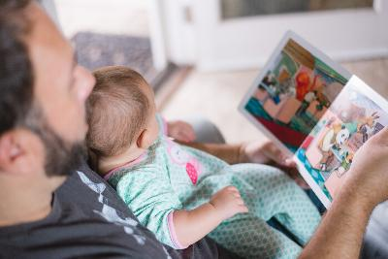
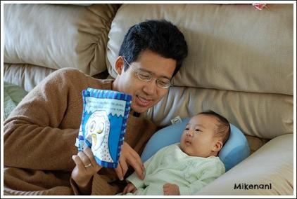
Its never too early to start…
Babies in the womb hear sounds as early as 18 weeks.
Providing newborn babies black and white books from birth is very stimulating whilst their eyes are developing
Singing and talking to your babies provides foundations for their language development.
Sharing stories with babies looking at pictures and naming objects develops their language skills, vocabulary and also understanding
Cuddling up together with a story is a wonderfully calming addition to a babies daily routine

Slide 4
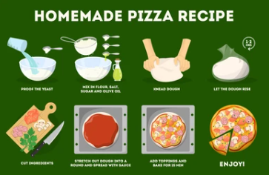

Encouraging a love of reading
Provide a good role model
Provide a variety of different reading materials
Encourage activities that require reading
Write little notes to your child and hide them around the house or in their lunch box so they can go on a hunt to find them
Reread your child’s favorite stories as many times as your child wants to hear them
Allow them to listen to audio books or watch stories on you tube
Notes:
- Some for reading enjoyment and some with information about hobbies and interests.
Encourage family and friends to share books with your child. The more your child sees you and others reading, the more they will want to read too.
— recipes for cooking, reading instructions to build something for example lego, reading a map or directions to get to a certain place, finding out information identifying an interesting bird or a shell collected at the beach using a reference book or the internet.

Slide 5
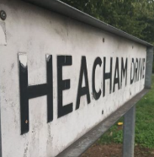





Print is all around us…
Signs
Street names
Shop names
Toy labels
Clothing labels
Food labels

Slide 6
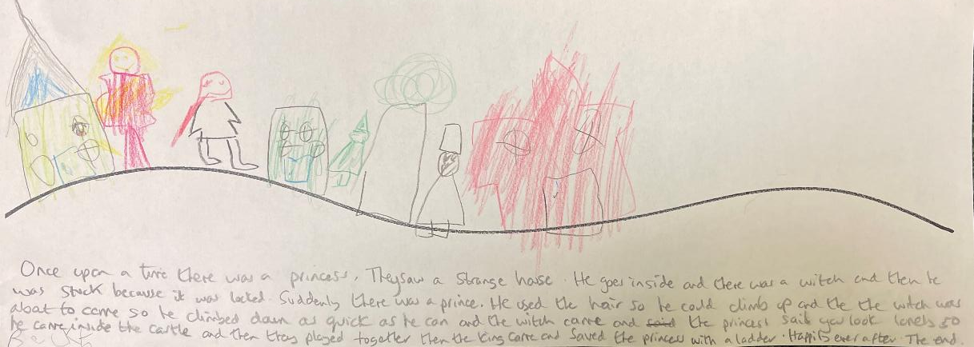
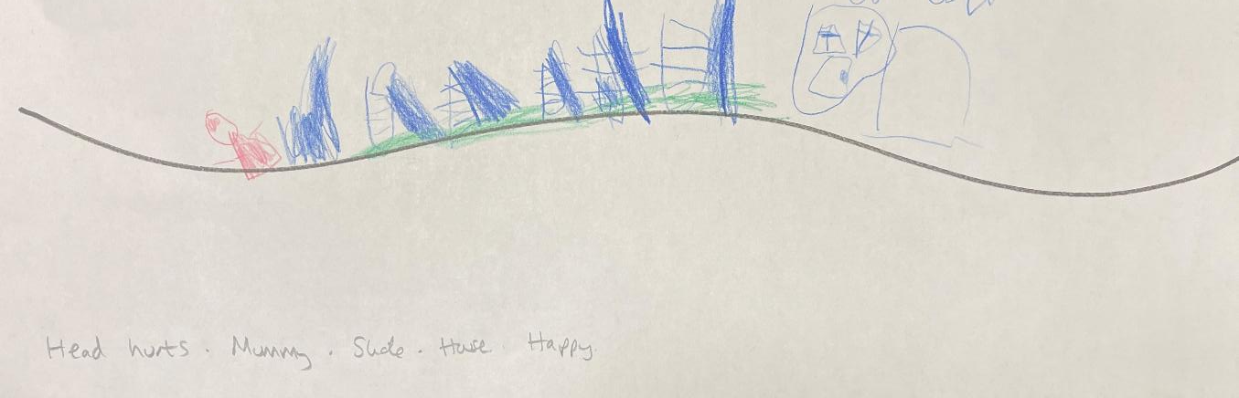
Story telling…
Once upon a time....
They lived happily ever after....
The end...
Notes:
Use imagination, don’t feel silly you don’t need lots of skills

Slide 7
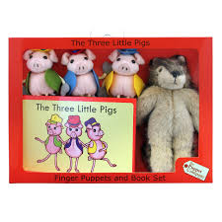
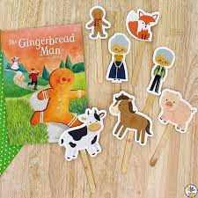
Other ways to encourage story telling.
Using puppets to retell a story
Making up stories with small world figures
Use different voices
Notes:
You could encourage your child to hold the book themselves and turn the pages. Use funny voices, puppets or props to bring the story alive.
such as ‘What can you see on this page?’, ‘How do you think the characters feel?’ and ‘What is the story about
For example, ‘Can you find a bird or a cat?’, ‘What else can you see?’, ‘What are the children playing? Have you played that before?’

Slide 8
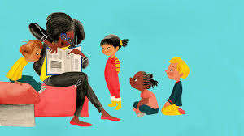
Top tips when reading to your child
Sit close together, cuddle up and get comfy
Use made up and funny voices for different characters to make the story exciting
Ask lots questions
Make sure they understand
Look at the pictures and talk about them
Have fun

Slide 9
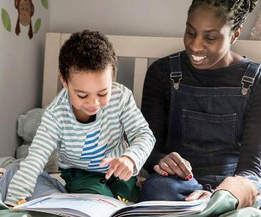
Things you might do when reading together:
Retell the story
Compare to other stories you have read:
“Does this remind you of anything?”
Background knowledge
“This reminds me of…”
Predicting
With picture books and chapter books
At the beginning of the story and throughout
Giving opinion
“What did you think about…?”
Books
Characters
Places
Decisions

Slide 10
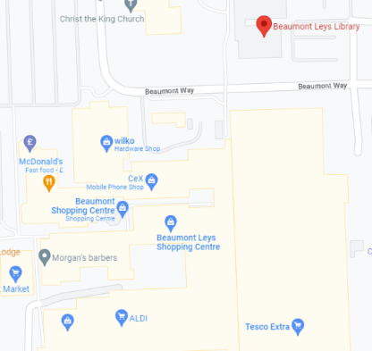
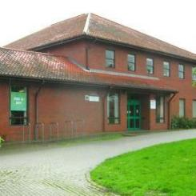
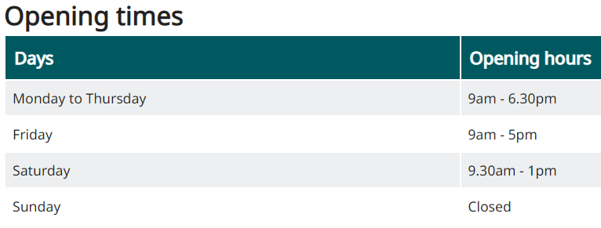

Beaumont Leys Library Service
Visit the local library together, it a great way to keep your children busy and best of all it costs nothing!
You will have fun and also be able to meet other families.
You can share stories and spend as long as you want in the library.
You can choose new books to borrow and take home.
Also look out for and ask about events or regular classes that you can join in with.
Contact: 0116 299 5460

Slide 11

How you can help at home
Read LOTS! Share stories wherever and whenever possible!
Talk to your children and talk out loud!
Listen to your children and support the correct speech sounds (parroting)
Phonics games and online games can help here are a list we think are useful.
Read environmental print e.g shop names
Sing nursery rhymes and songs
Use puppets, soft toys or figures to make your own stories

Slide 12
ICT websites to support literacy
https://www.phonicsplay.co.uk
https://www.teachyourmonster.org/
https://www.topmarks.co.uk/english-games
https://www.phonicsbloom.com/uk/game/list/phonics-games

Slide 13
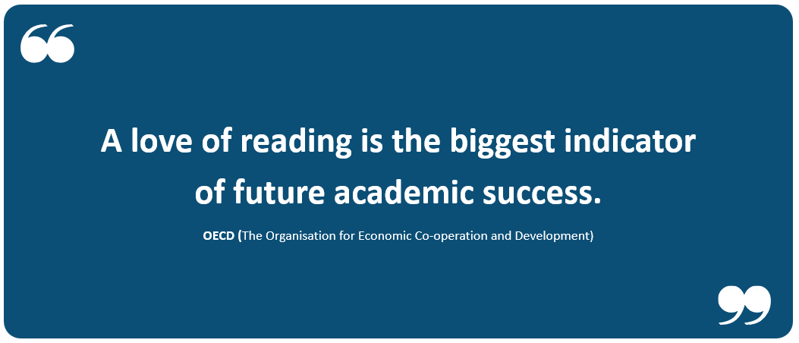
Teach reading: change lives
How we teach reading at
Barley Croft Primary School
Parent workshop 2: Phonics and Early Reading
Mrs Winfield – English Lead

Slide 14
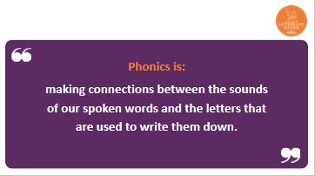
Phonics is:
Our school has chosen
Little Wandle Letters and Sounds Revised as our systematic, synthetic phonics (SSP) programme to teach early reading and spelling.
Little Wandle Letters and Sounds Revised
Notes:
It sounds complicated but it really isn’t!

Slide 15
Terminology
Split vowel digraph
Phoneme
The pure sound you speak
The written alphabet letter
2 letters that make 1 sound – Sh, ch, th etc
3 letters that make one sound – igh, air, ear etc
Putting the sounds together to say the word they make
Saying the individual sounds in the word
Grapheme
Digraph
Trigraph
Blend
Segment
Notes:
Explain what each word means – use our glossary to help: https://www.littlewandlelettersandsounds.org.uk/resources/my-letters-and-sounds/getting-started/

Slide 16
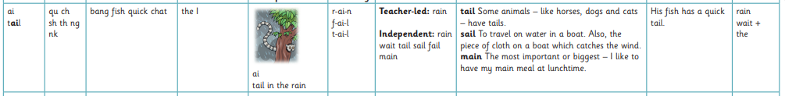
Learning to read
Learn the phoneme sounds in phonics
Oral blending skills to hear the sounds and blend them together
Begin to say the sounds they see and blend them together independently
Begin to blend in their heads to just read the word – Helps to aid fluency

Slide 17
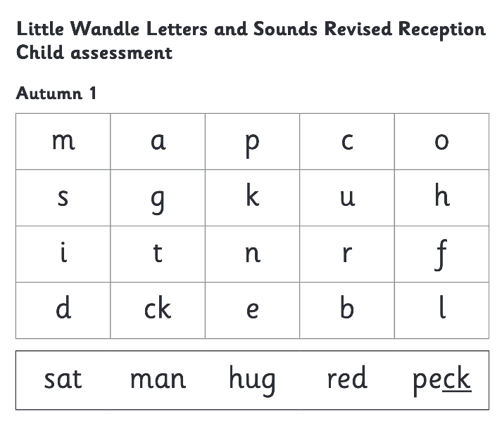
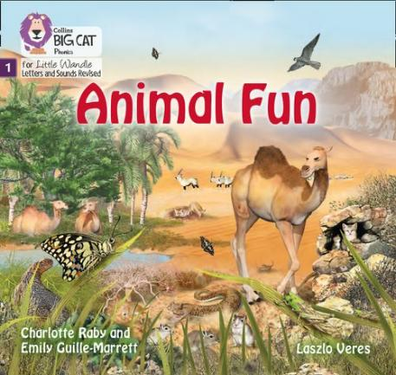
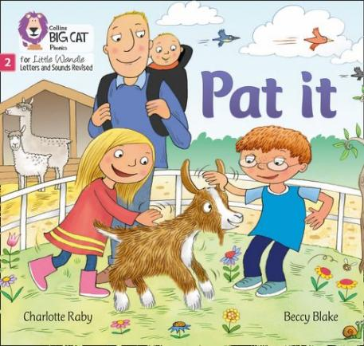

We use assessment to match your child the right level of book
Notes:
We assess your child every six weeks to check progress. Any child who needs extra support has daily keep-up sessions planned for them.

Slide 18
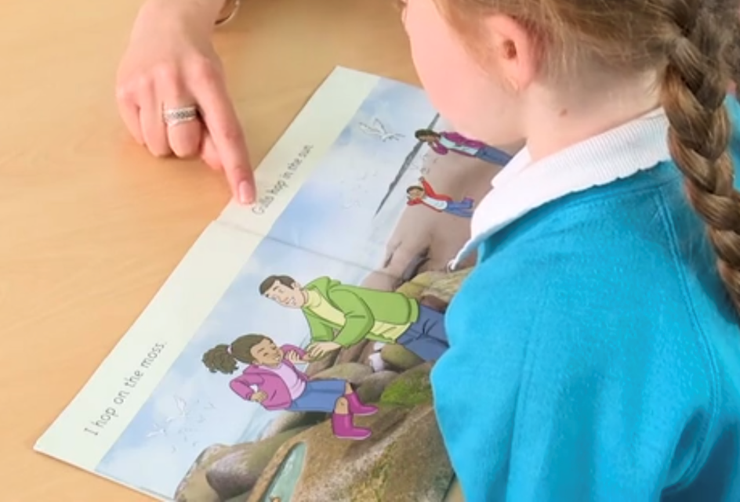
Reading a book at the right level
This means that your child should:
Know all the sounds and tricky words in their phonics book well
Read many of the words by silent blending (in their head) – their reading will be automatic
Only need to stop and sound out about 5% of the words by the time they bring the book home – but they should be able to do this on their own.

Slide 19
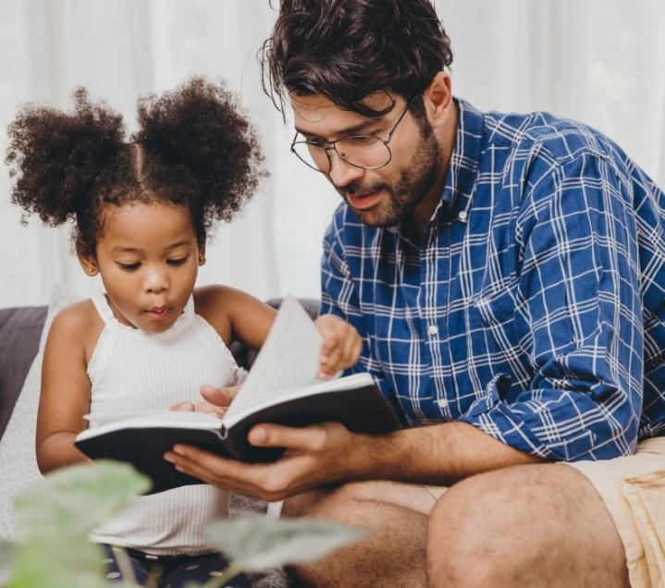
The most important thing you can do is read with your child
Reading a book and chatting had a positive impact a year later on children’s ability to…
understand words and sentences
use a wide range of vocabulary
develop listening comprehension skills.
The amount of books children were exposed to by age 6 was a positive predictor of their reading ability two years later.
Parental involvement in the development of children’s reading skills: A five-year longitudinal study (2002) Senechal, M. and Lefvre, J
Notes:
Celebrate child’s success at school, make time for reading at home!

Slide 20

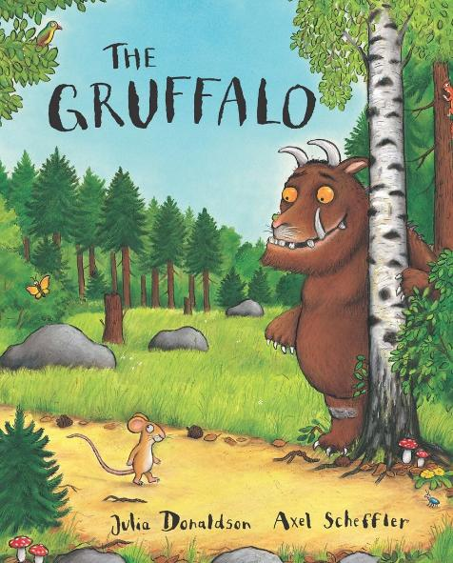
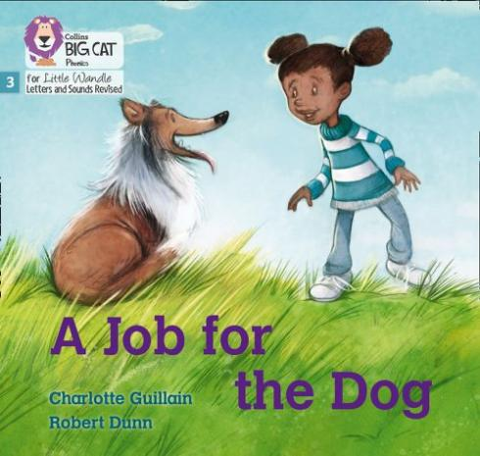
Books going home
Notes:
As well as the ‘learning to read’ book that your child will bring home they will also bring home a book for sharing with you. This book is SO important. This is how we are going to give them the WILL to read. Please read with your child as often as you can – at least once a day if possible.

Slide 21

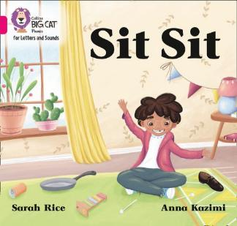
Listening to your child read their phonics book
Your child should be able to read their book without your help.
If they can’t read a word, read it to them.
Talk about the book and celebrate their success.

Slide 22
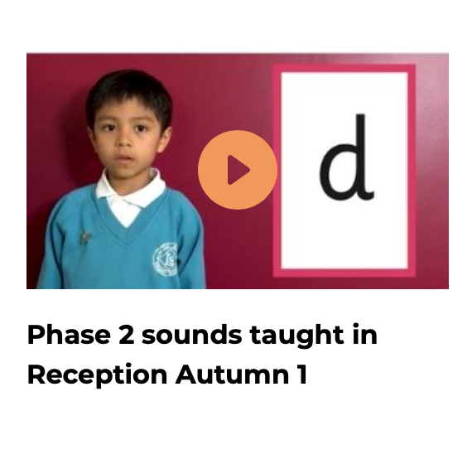
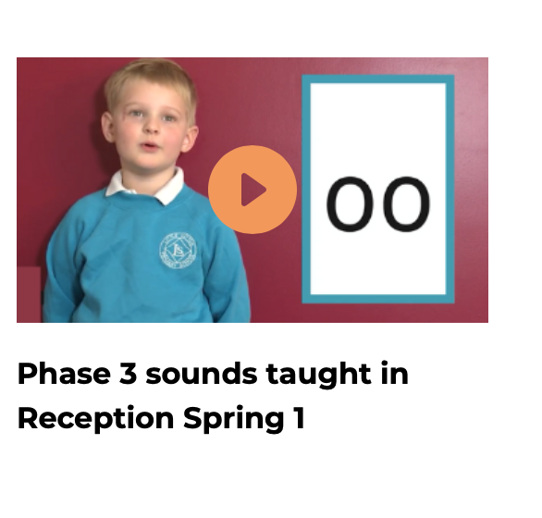
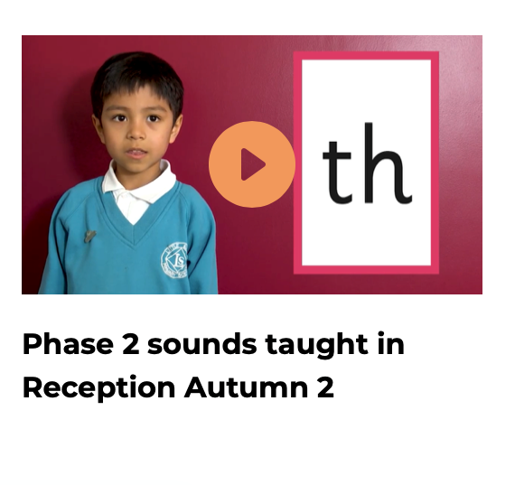
Supporting your child with phonics
Notes:
It is really important that you pronounce the sounds correctly at home if you are supporting your child. These videos are on the website for you to refer to and if you are unsure, please ask your child’s teacher.
Show the parents where to access the videos on the website and play them!
https://www.littlewandlelettersandsounds.org.uk/resources/for-parents/

Slide 23

Read to your child
The shared book is for YOU to read:
Make the story sound as exciting as you can by changing your voice.
Talk with your child as much as you can:
  Introduce new and exciting language
  Encourage your child to use new vocabulary
  Make up sentences together
  Find different words to use
  Describe things you see.

Slide 24
The sharing book
Chosen by the children
Borrowed from our school library
Changed weekly
Read to the child – sharing the story together
A great opportunity to discuss the story – this can be done in your home language.

Slide 25
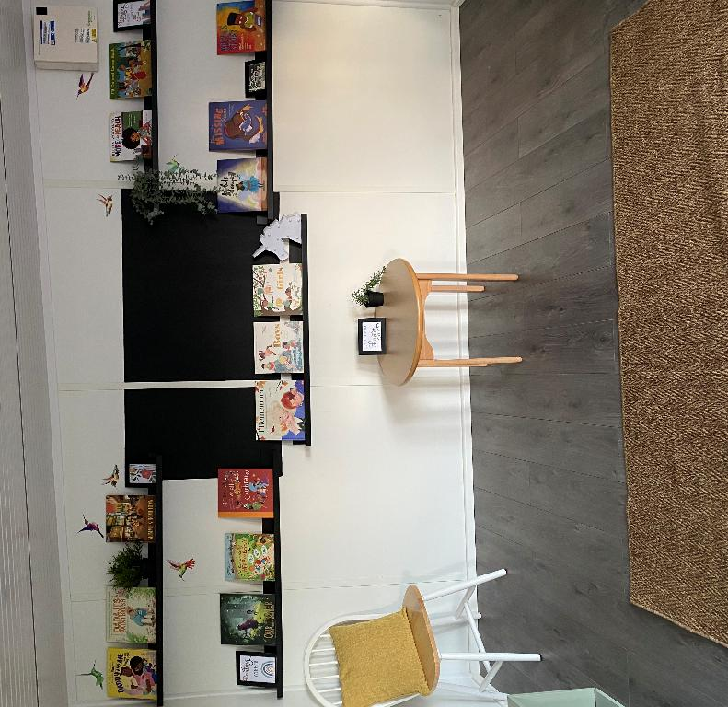
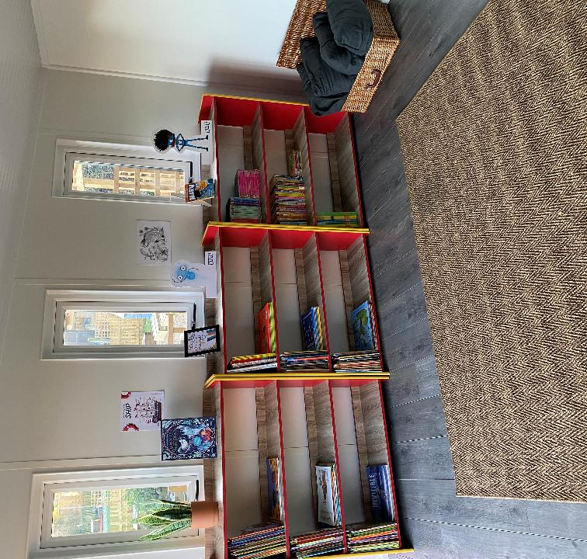
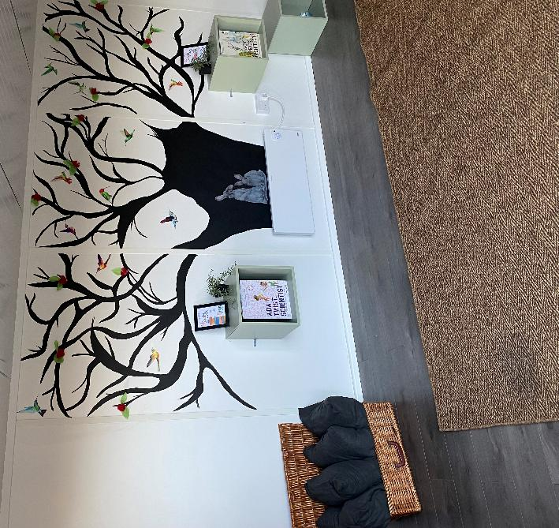
EYFS & KS1 library

Slide 26


