Slide 1

Welcome to
Year 3 and 4

Slide 2
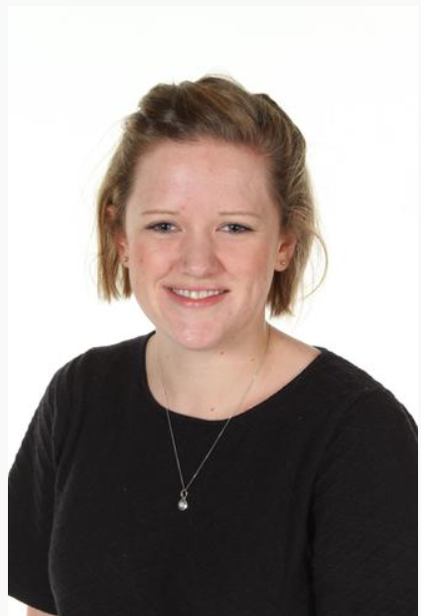
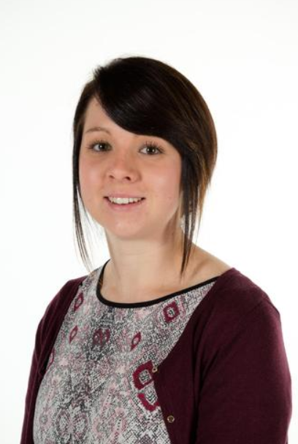
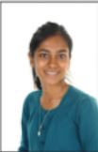
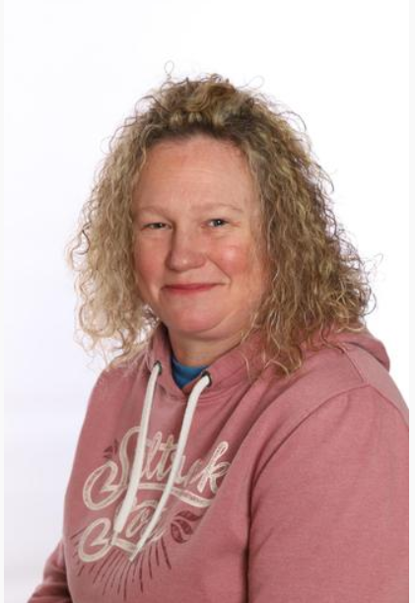
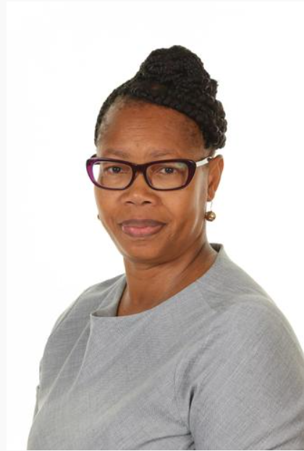
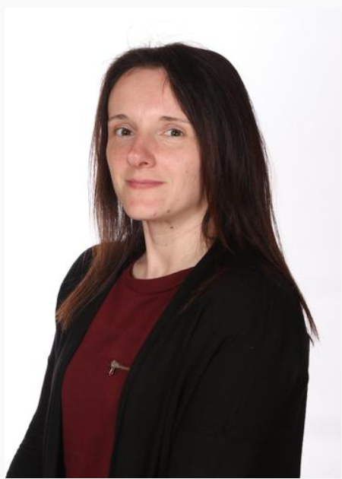
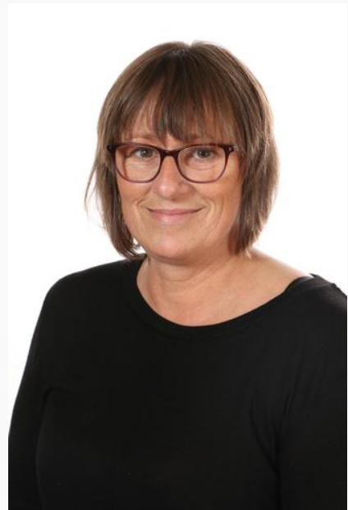
Meet the Team:
Mrs Bromley Miss Cockram Mrs Guedes Mrs Sumner
Miss Rainford Mrs Frith Miss Plumb
Notes:
Add in photos of staff

Slide 3






English – Autumn Term
Year 3 and 4
Character Description
Diary Entry
Fact File
Narrative
Reading

Slide 4


Maths – Autumn Term
Year 3 and 4
Place value
Addition and subtraction
Multiplication and division

Slide 5
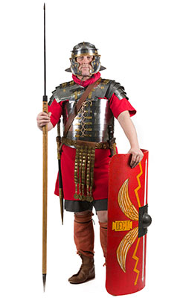
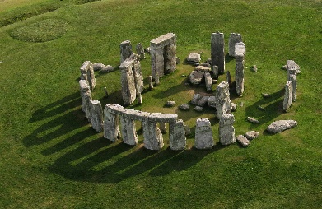
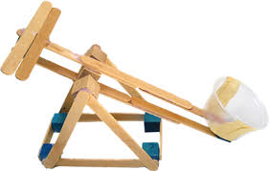





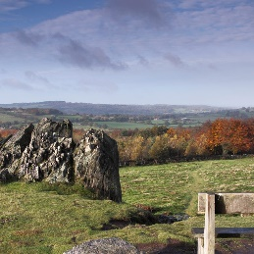

Project –
Who Made Britain?
Project Take off
Trip to Beacon Hill
Project Landing
Parent Exhibition

Slide 6
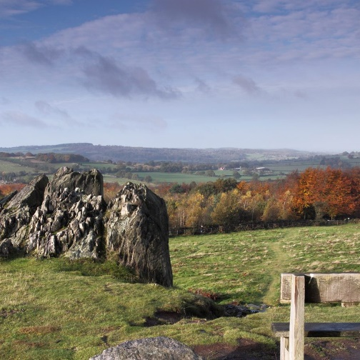
Trip –
Beacon Hill
4th September 2024
During School hours
Lunch
Water bottle
Bag
Appropriate shoes!
Clothing
£5

Slide 7


Homework
Daily – Reading and times tables
Weekly Spellings
Weekly Homework – English and Maths
Termly family homework challenge

Slide 8


Homework…

Slide 9


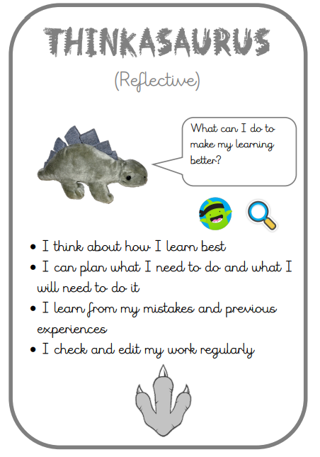
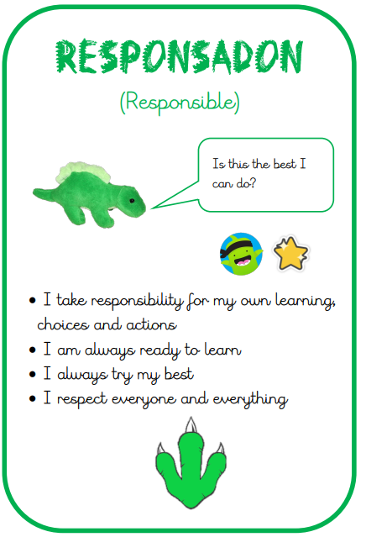
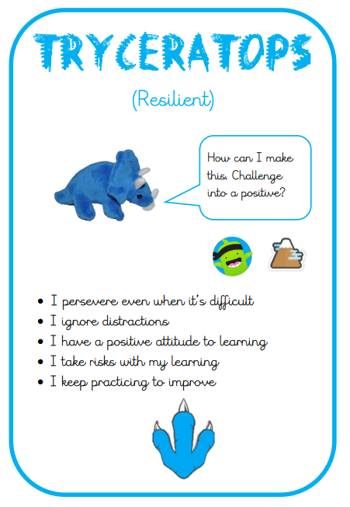
Learning Powers

Slide 10

Class Dojo
Barley Croft Dojo Shop

Slide 11
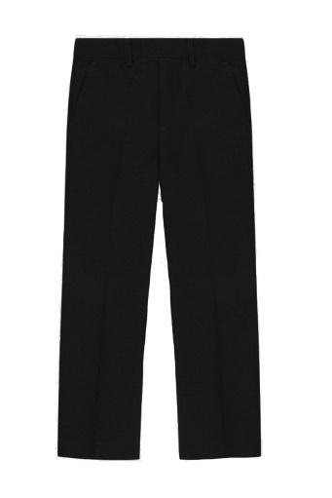
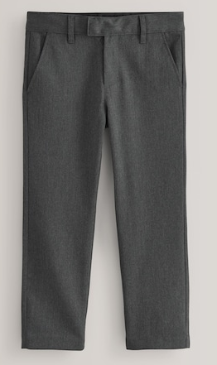
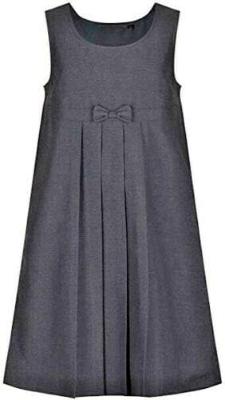
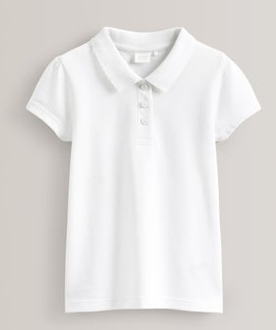
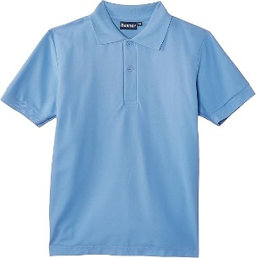
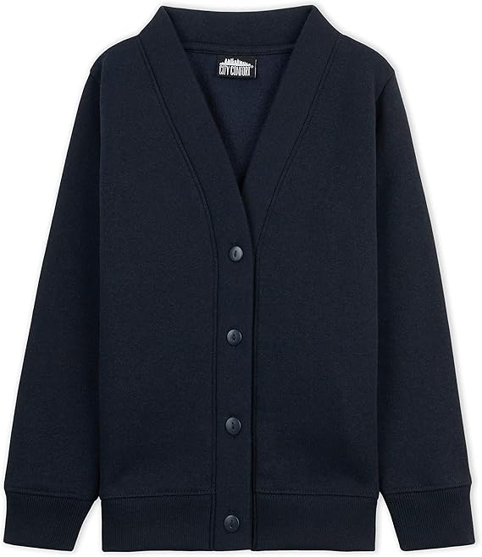
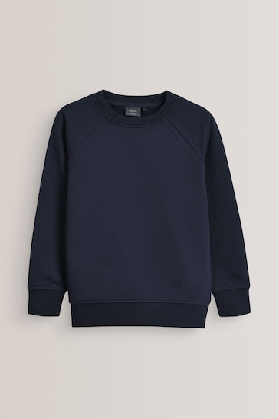
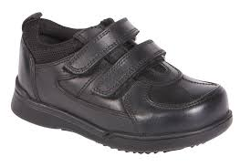
School Uniform

Slide 12
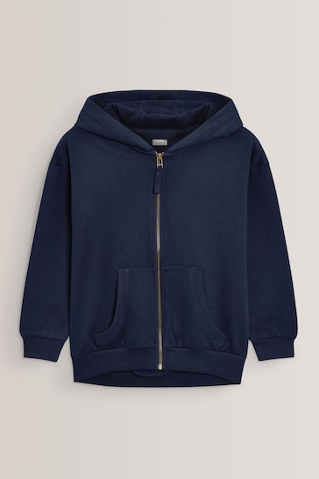
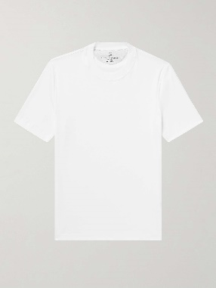

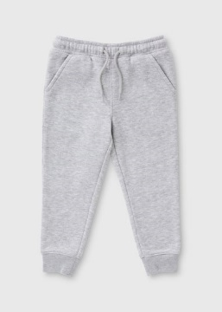
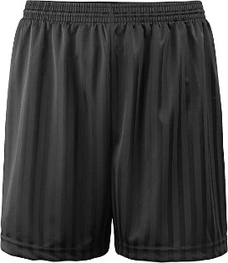
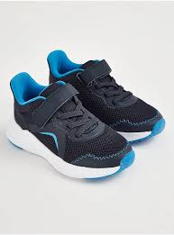
PE
Please ensure children come to school on their PE day dressed in PE kit.
Integrity – Mrs Sumner
Monday
Ambition - Mrs Guedes
Monday
Democracy - Mrs Bromley and Miss Cockram
Thursday
*

Slide 13
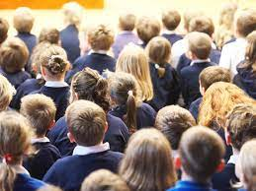


Returning this year…
Parent
Exhibition

Slide 14


Reminders

Slide 15
Contact
Class Teacher / Teaching Assistant
Phase Leader (Mrs Bromley)
Senior Leader (Mr Easton, Mrs Ellson, Mr Canham &Mrs Dulieu)

Slide 16
Questions…

