Slide 1
Welcome to Year 5 and 6!

Slide 2

Meet the Team
Miss Gangat
Mrs Ellson
Mrs Dennis
Mrs Pallatt
Miss Simmonds
Mrs Hussain
Notes:
Add in photos of staff

Slide 3
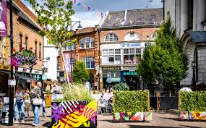

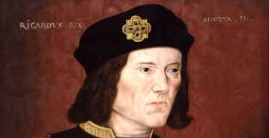
Literacy
Term 1
Non-Chronological report
Character description
Description of battlefield
Term 2
Dialogue
Narrative
Letter

Slide 4
Maths – year 5
Year 5
Place value
Addition and subtraction
Graphs and tables
Multiplication and division
Measure : Area and perimeter

Slide 5
Maths – year 6
Year 6
Place value
Four operations
Fractions
Geometry, position and direction

Slide 6
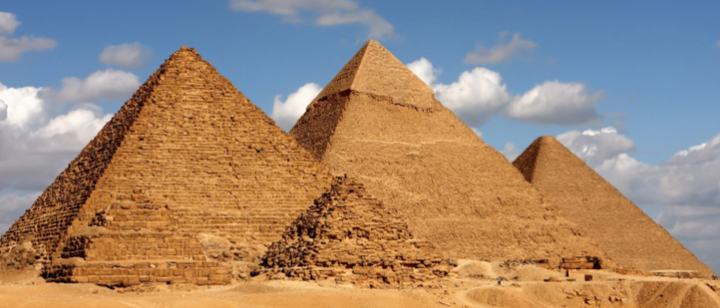

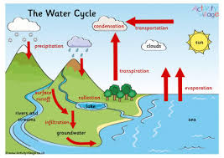
Real project : How did we end up here?

Slide 7
Homework
Daily reading – books in book bag – changed weekly
Daily times tables – record in diary
4 x reading and 4 x maths a week
Weekly spellings
Termly family homework challenge

Slide 8
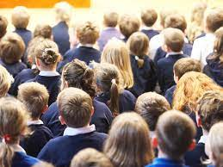


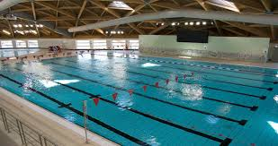
Returning this year…

Slide 9
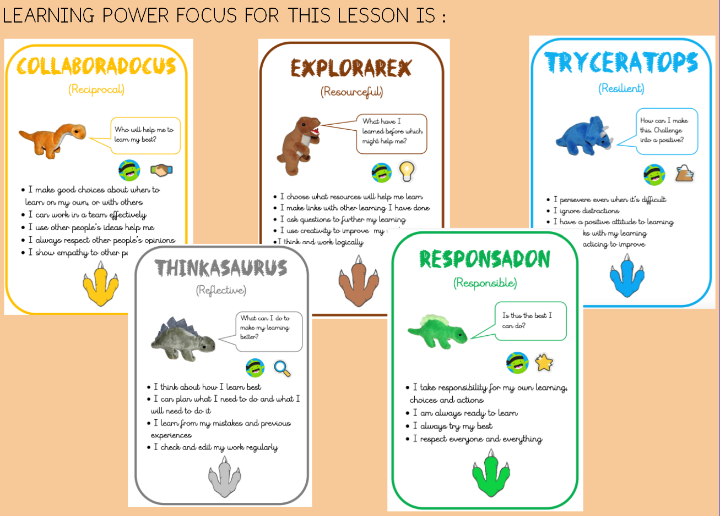
Learning Powers
Responsadon
Tryceratops
Collaboradocus
Explorarex
Thinkasaurus

Slide 10

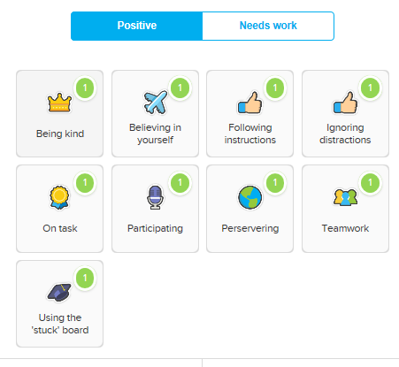
Class Dojo Shop

Slide 11
School Uniform
Navy blue jumper or cardigan. Purchased at most supermarkets. Jumpers and cardigans with the Barley Croft logo can be purchased at the school office.
Black or grey trousers, skirts or pinafore dresses (no jeans, including black denim) Leggings should only be worn under skirts and not as trousers.
A white or blue polo shirt, blouse or shirt.
Black, sensible shoes or ankle boots (no high-tops, knee high boots, sandals or heels)
Black, white or grey plain socks, tights or leggings
No jewelry apart from small, discrete stud earrings
No make-up, including nail varnish

Slide 12
PE Days
Miss Gangat
Friday
Mrs Ellson
Tuesday
Mrs Dennis
Thursday swimming
Please ensure children come to school on their PE day dressed in PE kit.
It has to be a PE Kit not fancy clothes

Slide 13
PE Kit
Plain black/navy shorts (for indoor PE)
Plain black/navy jogging bottoms (for outdoor PE)
Plain white T-shirt (a white PE T-shirt with the Barley Croft logo can be purchased from the school office).
White, black or blue trainers (not high-tops or boots) – KS2

Slide 14


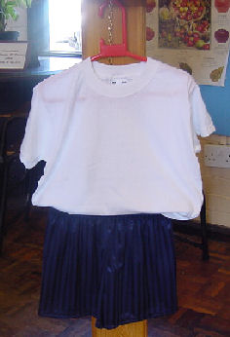


Reminders

Slide 15
Contact
Class Teacher / Teaching Assistant
Phase Leader (Miss Gangat)
Senior Leader (Mr Easton, Mr Canham, Mrs Dulieu & Mrs Ellson)

Slide 16
Questions

