Slide 1

Parent Workshop – Behaviour
Tuesday 16th January 2024

Slide 2





Slide 3

How do we set the expectations for pupil behaviour in our school ?

Slide 4


Slide 5
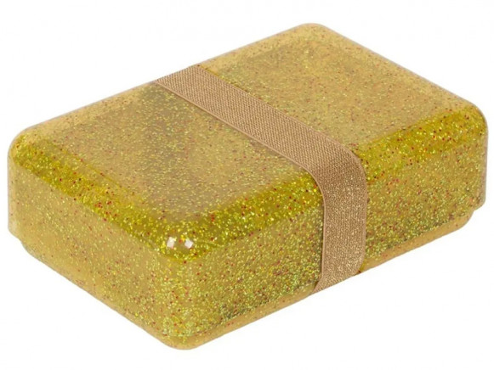


Rewards
Golden Lunchbox
Dojo Points
Pom Poms

Slide 6



Consequences

Slide 7





Slide 8


Slide 9

bullying or bothering ?

Slide 10

What is bullying ?
Bullying is when someone purposely hurts someone else physically or emotionally , repeatedly over time.

Slide 11
What is bothering ?
Bothering is when someone annoys or upsets you. It might be a disagreement or falling out , someone following you around or being rude or unkind.

Slide 12



Slide 13
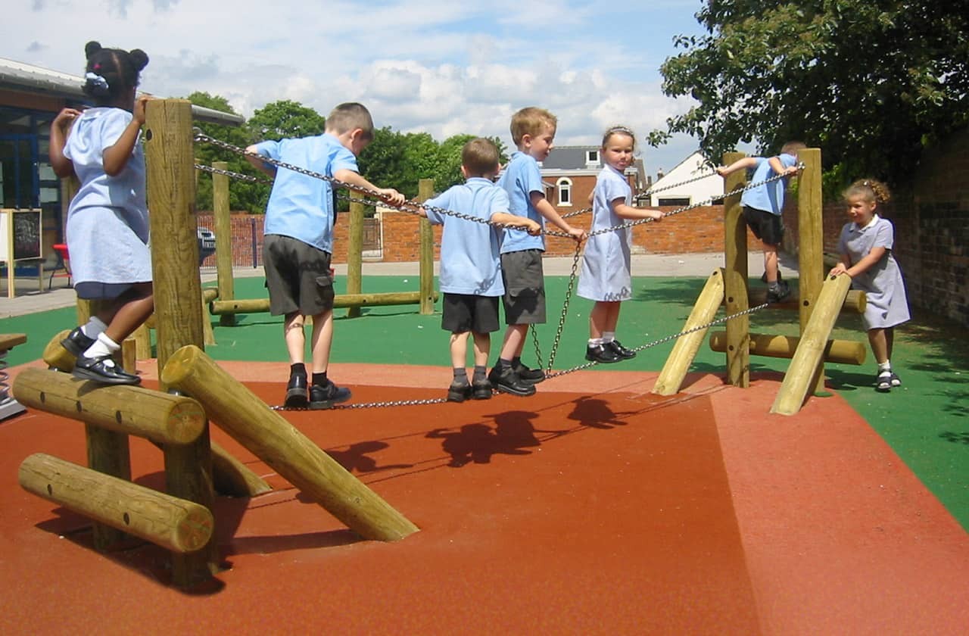

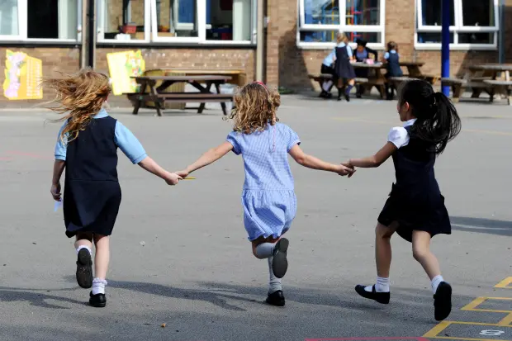
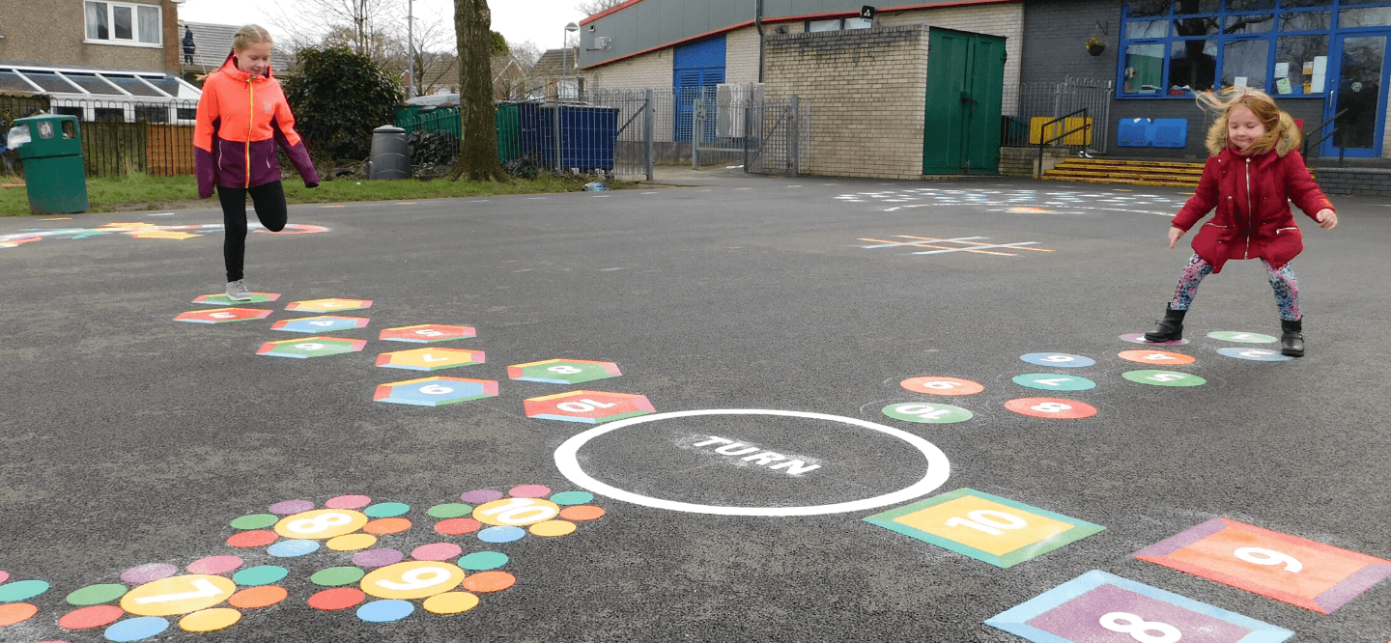
Playtime

Slide 14
In the playground…
We play nicely together and don’t hurt others
We look after all the equipment and use it sensibly
We show respect to everyone
We tell someone if we feel bothered by something, or if we are sad, upset or unhappy so someone can help you.

Slide 15
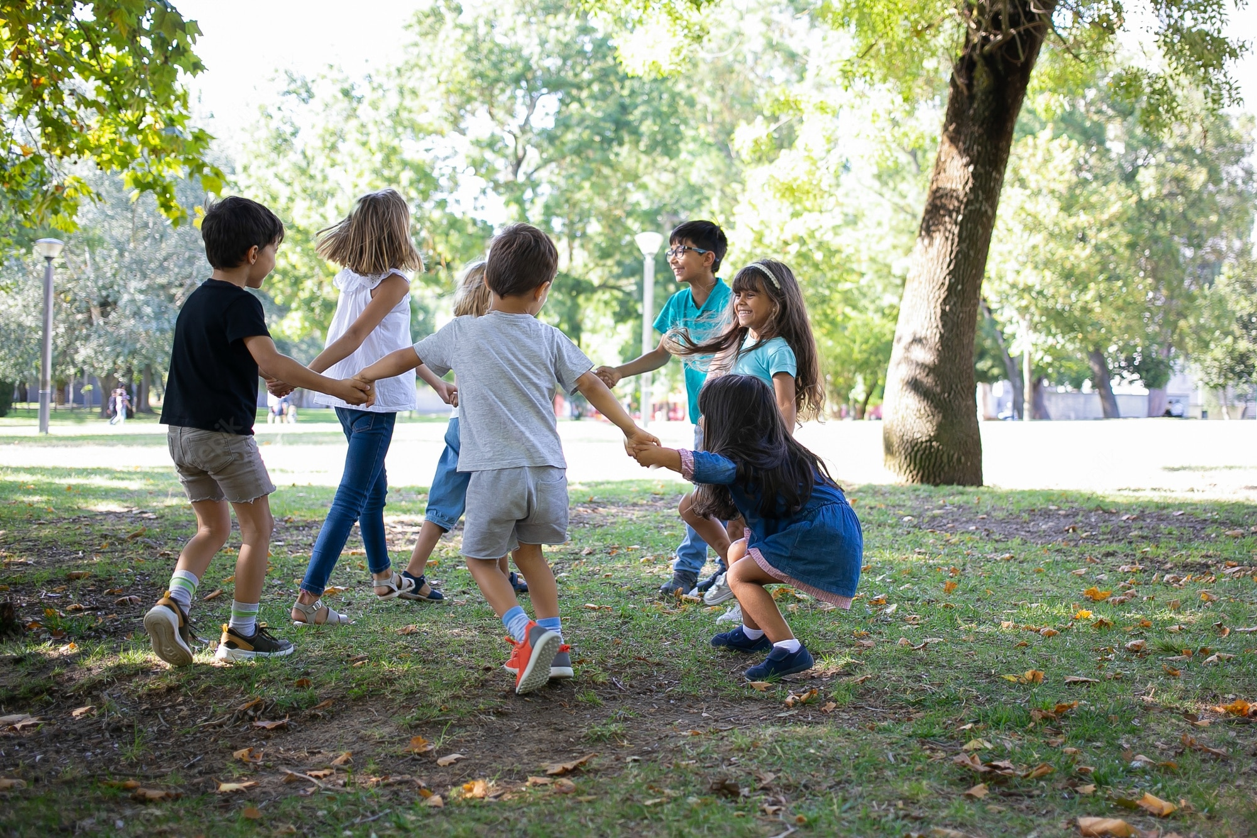
Play together and choose games that don’t hurt others.

Slide 16
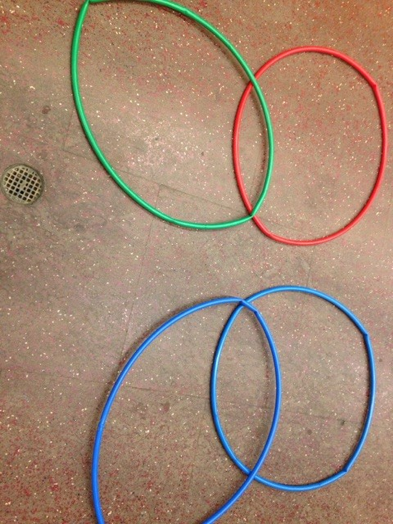

Look after the equipment

Slide 17

Show...
to everyone

Slide 18
Our school behaviour policy is on our website (look under Key Information – Policies and Guidance – Behaviour Policy 23/24 )
https://www.barleycroft.leicester.sch.uk/

