Slide 1

Year 1/2 Welcome Meeting
28.8.25
Notes:
SW

Slide 2
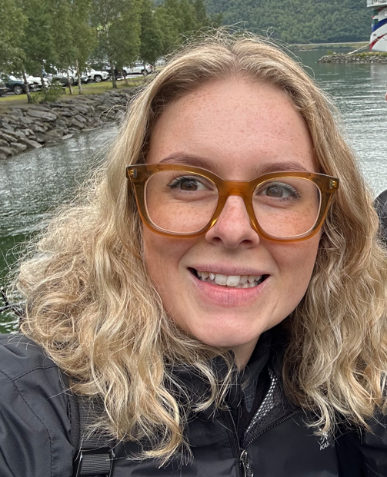
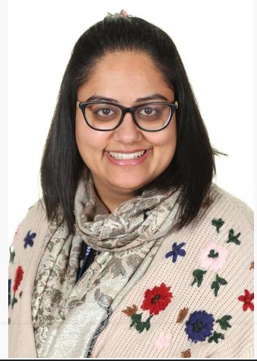
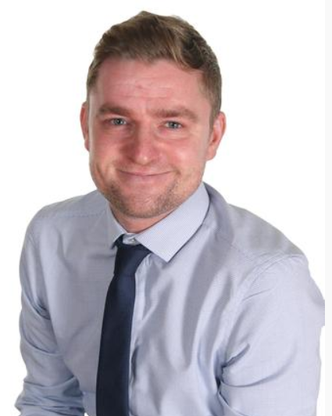
Meet the Team
Mrs Winfield
Kindness (Year 1/2)
Miss Banning
Courage (Year 1)
Mr Easton
Honesty (Year 2)
Classroom Assistants
Mrs Miller
Miss Billie
Miss Andrews
Mrs Huntley
Miss Dodman
Miss Khan
Notes:
SW

Slide 3
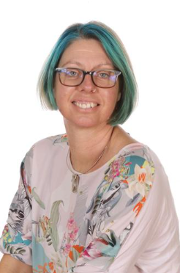
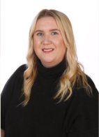
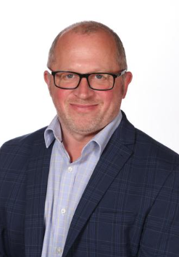
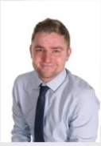
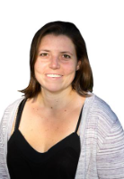
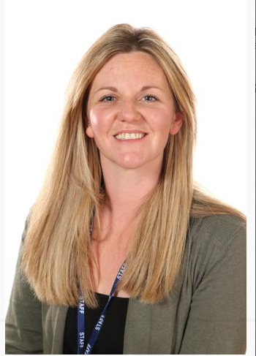
Safeguarding Leads
Mrs Dulieu
Headteacher
Mr Canham
Deputy Headteacher
Mr Easton
Assistant Headteacher
Mrs Bonshor
SENDCo
Emily Roberts
Family Link Worker
Sian Buckler
Pastoral Support
Notes:
AE
Sian
Attendance Lead – monitor pupil’s absence and work alongside education welfare to increase pupil’s attendance and punctuality
Social and emotional interventions – small group and 1:1 sessions to support pupil’s emotional well-being
Behaviour support – monitor the behaviour of pupils in school and work with them to aim for better outcomes
Emily
- Supporting families with financial difficulties/housing
- Supporting with family separation
- Food bank referrals/referrals to family support agencies e.g Early Help
- Home visits when necessary and appropriate to check the welfare of a family

Slide 4
The School Day
School gates open at 8.35am.
Whistle blown at 8.40am and school doors open.
Gates closed by 8.45am.
Please take your child to the office to sign in if you are late.
Start of the day:
Kindness – corridor next to the classroom
Honesty – corridor next to the classroom
Courage – corridor next to the classroom
End of the day:
Kindness – classroom door
Honesty – classroom door
Courage – classroom door
Teachers available at the end of the day for queries.
Please be patient with us whilst we learn new faces at the end of the day.
Notes:
GB

Slide 5
School Uniform
Navy blue jumper or cardigan. Purchased at most supermarkets. Jumpers and cardigans with the Barley Croft logo can be purchased at the school office.
Black or grey trousers, skirts or pinafore dresses (no jeans, including black denim) Leggings should only be worn under skirts and not as trousers.
A white or blue polo shirt, blouse or shirt.
Black, sensible shoes or ankle boots (no high-tops, knee high boots, sandals or heels)
Black, white or grey plain socks, tights or leggings
No jewellery apart from small, discrete stud earrings
No make-up, including nail varnish
Notes:
SW

Slide 6
PE Kit
Please ensure children come to school on their PE day dressed in the correct PE kit.
Plain black/navy shorts (for indoor PE)
Plain black/navy jogging bottoms (for outdoor PE)
Plain white T-shirt (a white PE T-shirt with the Barley Croft logo can be purchased from the school office).
White, black or blue trainers (not high-tops or boots)
Notes:
GB

Slide 7
PE Days
Mrs Winfield (Kindness)
Friday
Miss Banning (Courage)
Tuesday
Mr Easton (Honesty)
Friday
Please ensure children come to school on their PE day dressed in the correct PE kit.
Notes:
GB

Slide 8

Reading & Phonics
Little Wandle Phonics
Children will continue to have daily Phonics lessons and bring home Phonetically decodable reading books. They will read it 3 times at school so they are gaining confidence when they bring it home. Celebrate how confident they are at reading the words!
If they are unsure of any words, prompt them to identify the individual sounds (segment) and then blend them together to read the words. Some words are tricky – they just need to be able to read them!
Year 2 children who passed the Phonics screening check in June will do a final term of Phonics before moving to the next stage of Little Wandle to gain more reading fluency and develop their comprehension skills.
Notes:
SW

Slide 9
Curriculum
Our REAL project question this term is:
I wonder what makes me marvellous?
Subjects we will be learning are:
Art – Self Portraits
Geography – Where am I from?
History – Changes within living memory
Science – Human body, Living things & Staying healthy
After half term…
History – The Gunpowder Plot
Notes:
AE

Slide 10
Homework
Daily reading – books in book bag – changed weekly
Kindness class (Mrs Winfield) – books changed on a Thursday
Courage class (Miss Banning) – books changed on a Friday
Honesty class (Mr Easton) – books changed on a Friday
Reading Records – online (‘Learning with Parents’ website)
Daily number facts, counting / times tables for Y2 – 2s, 5s and 10s).
Termly family homework challenge – look out on Weduc for details.
Notes:
AE
Make note that lost/damaged books will be charged for!

Slide 11
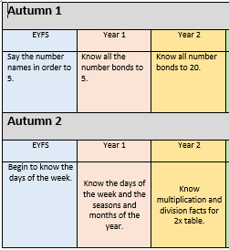
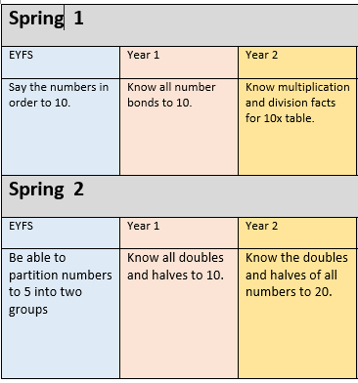
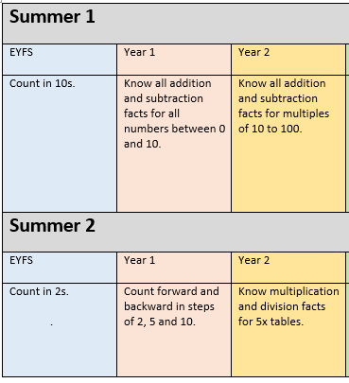
Maths Homework ideas
Notes:
SW

Slide 12

Seesaw
We will send home a family code and a code for your child to login and add any additional learning they do at home.
Notes:
SW

Slide 13

Learning Powers
Responsible - Responsadon
Resilient - Tryceratops
Reciprocal - Collaboradocus
Resourceful - Explorarex
Reflective - Thinkasaurus
Notes:
AE

Slide 14
Clubs
There will be a range of clubs on offer for children to attend after school.
Some clubs require payment online before your child attends each term.
Please look out for further information on Weduc or see the office for details of after school clubs.
Notes:
GB

Slide 15
Contact
Class Teacher / Teaching Assistant
Phase Leader (Mrs Winfield)
Senior Leader (Mrs Dulieu, Mr Canham, Mr Easton & Mrs Ellson)
Notes:
SW

Slide 16
Questions
Notes:
SW

